Slide 1


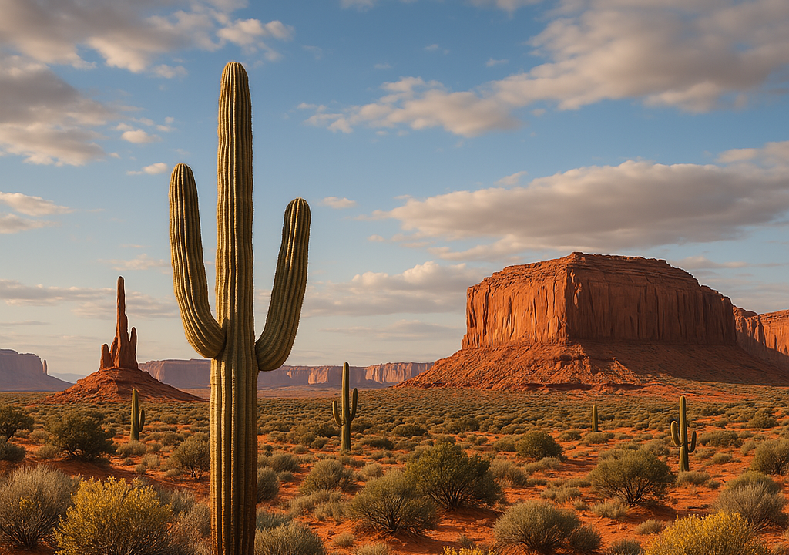
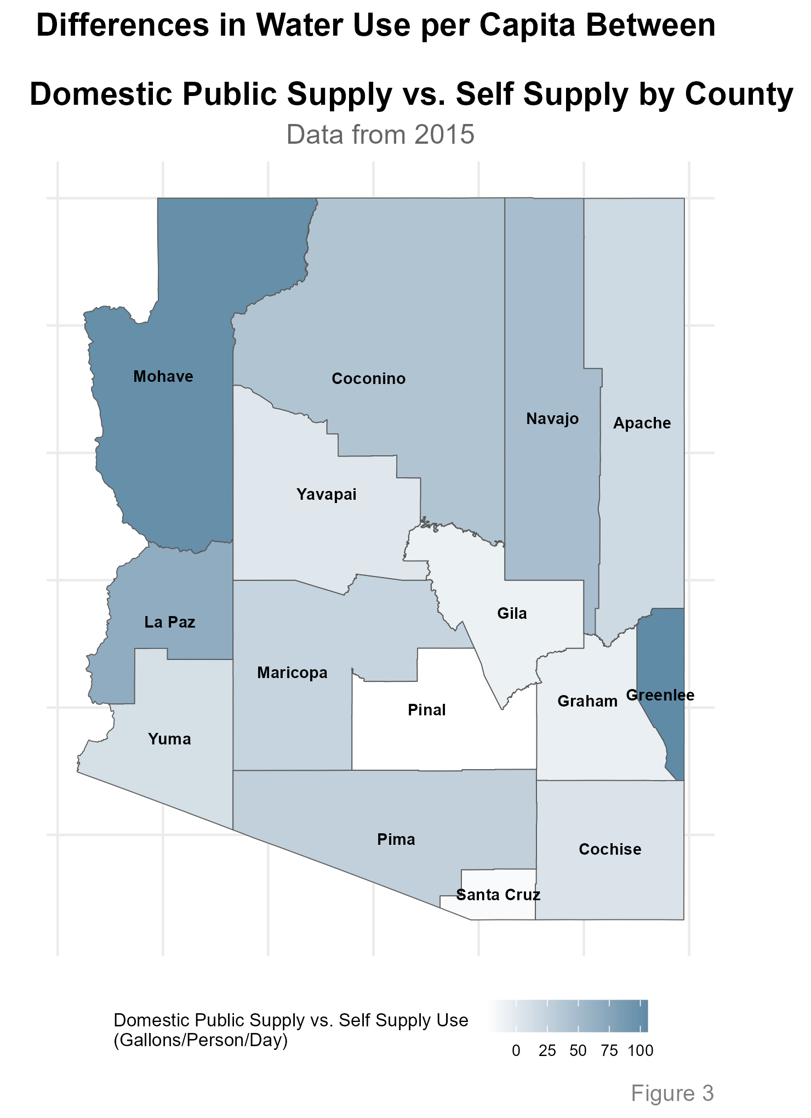
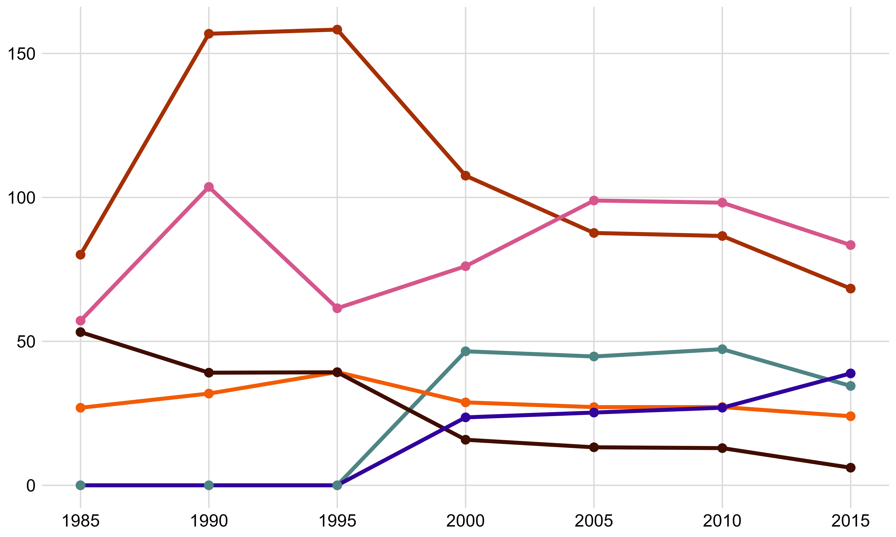
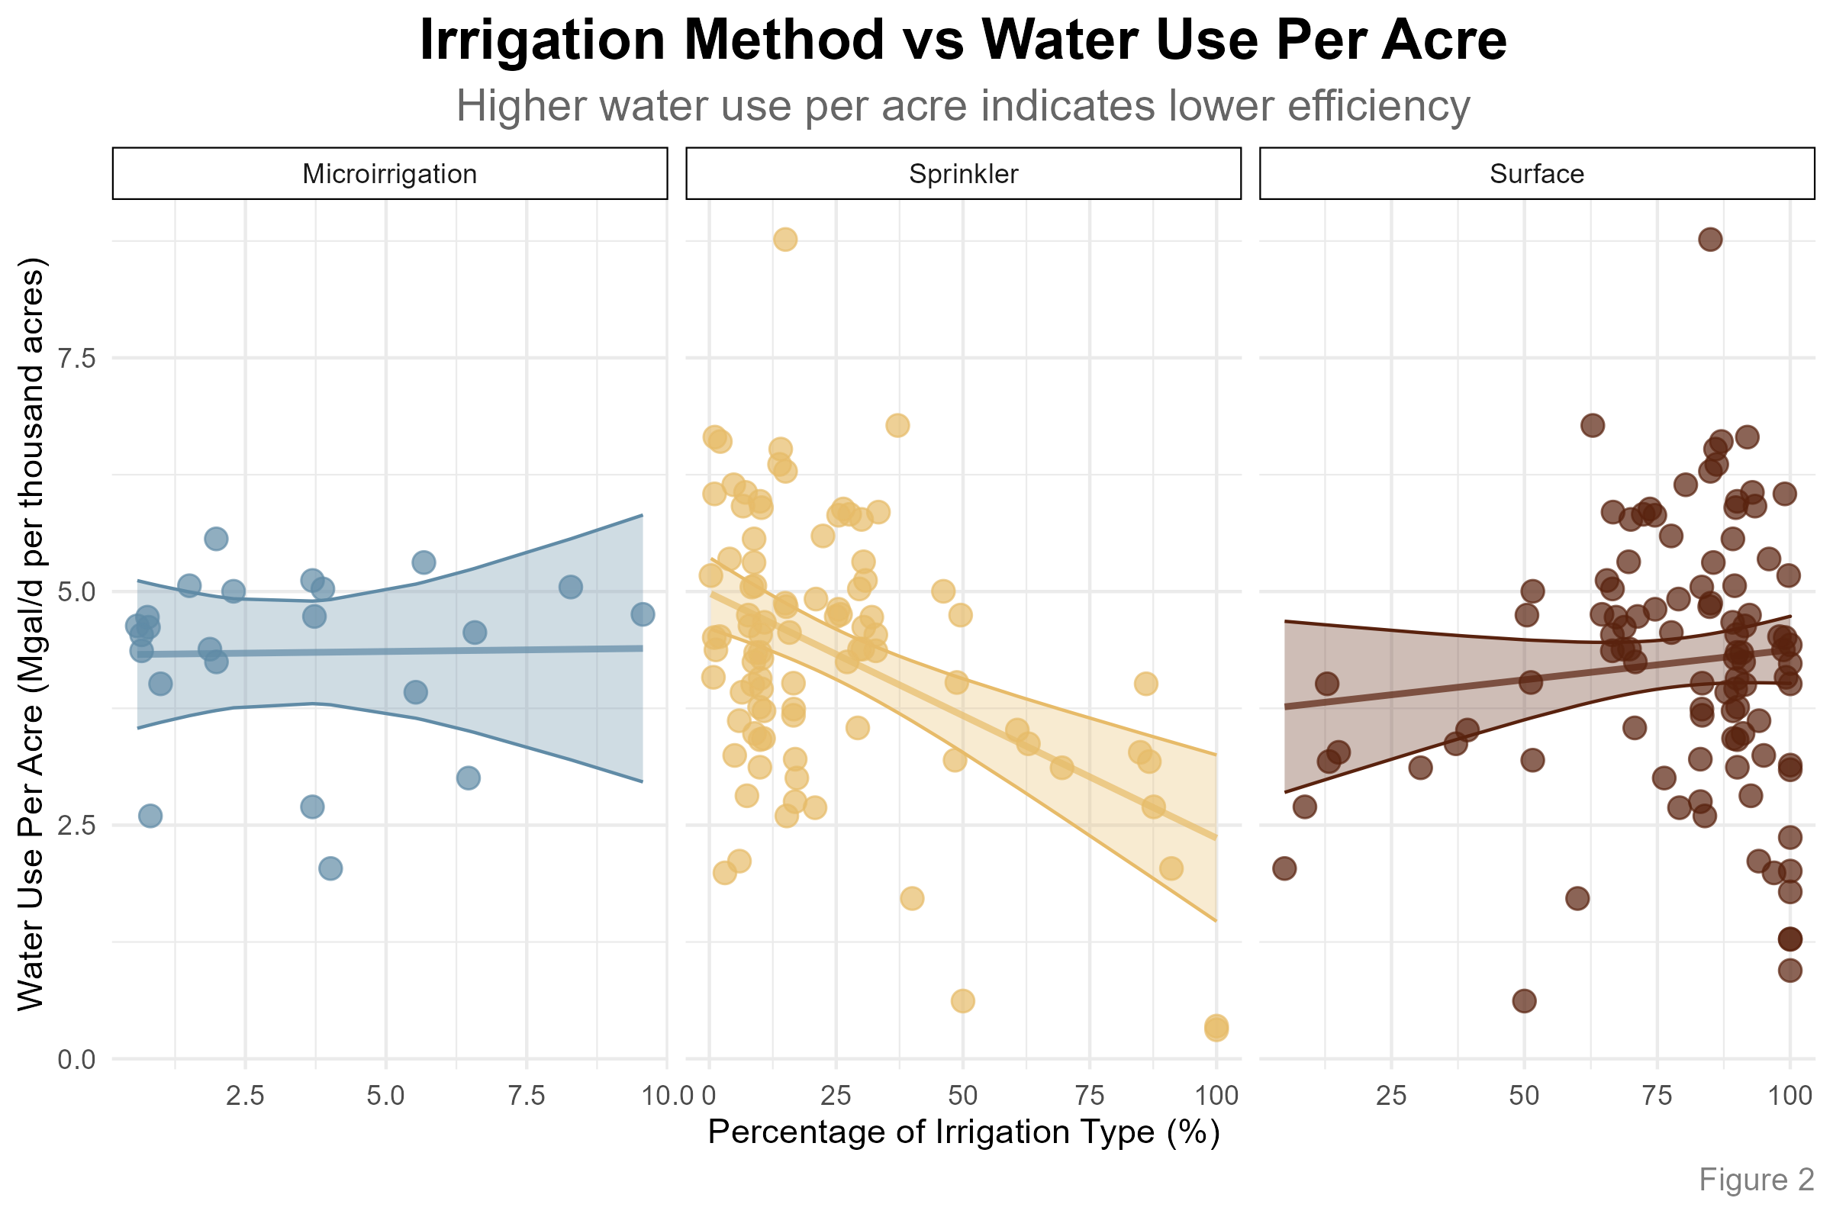

Arizona Water:
Jack Tomlon, Delila Medlin, Dr. Robert Buscaglia
The Pathogen and Microbiome Institute, Northern Arizona University, Flagstaff, AZ 86011
Our Problem
Analysis
Arizona is facing a critical water crisis due to a combination of prolonged drought, climate change, and overuse of water resources.
The Colorado River runoff has declined sharply, dropping reservoir levels in Lake Mead and Lake Powell to historic lows.
The combined reservoirs storage lost 33.5 million acre-feet in the past 20 years, leaving only 15 months of average consumption reserves.
Addressing these challenges requires substantial reductions in water use and the implementation of sustainable management practices to stabilize and recover water storage levels.
Over the past ~30 years, the overall water use in AZ has decreased
The vast majority of water in the state is used for Irrigation, then through Public Supply withdrawals.
We investigated water use in these top sectors and found:
The top method of Irrigation in the state is also the most inefficient in the industry.
Most water withdrawals from Public Supply go to Domestic use.
There is a large discrepancy between Domestic use from Public vs. Self-Supplied water.
The plot to the right shows the increases of water use per capita
Abstract
As of March 2025, a staggering 99% of Arizona was in a state of drought (US Drought Monitor 2025).
Decreases in precipitation in our state have brought about concerns for the future of Arizona’s water future, and how the state is going to sustain our growing population and water consumption rates.
This project analyzes water production and consumption data from the United States Geological Survey (USGS) to identify anomalies and investigate sectors exhibiting unusual water loss in Arizona. The data, collected from publicly available USGS resources includes information on water withdrawals, usage by sector, and sources such as surface and groundwater. The goal is to uncover patterns and discrepancies that may indicate inefficiencies or areas for improved water management. Additionally, this analysis explores the potential ethical and environmental benefits of increasing the use of reclaimed water within Arizona’s water management strategy.
By identifying opportunities to optimize water use and integrate sustainable practices, the project aims to support more informed decision-making for managing Arizona’s limited water resources sustainably.
A positive slope indicates low water use efficiency. A negative slope indicates high efficiency.
There is limited data on Microirrigation, so this relationship may not be properly reflected in this set.
Discussion
Arizona's water primarily goes to Industrial Agriculture Irrigation, with inefficient Surface Irrigation dominating, despite more efficient alternatives like Sprinkler and Microirrigation systems. While Agriculture remains vital to Arizona's economy, Irrigation efficiency can be improved.
One way AZ is trying to improve this through 42 USC 10364: Water Management Improvement Bill. This bill authorizes the Secretary (presumably of the Interior Department) to provide grants to improve water management. Though there are some drawbacks with the bill.
Limited Tribal Considerations
Ceiling on how much funding can be received
Ambiguous language on which projects are prioritized
Looking forward:…
Proportion of Irrigation method in Arizona
Year | Sprinkler | Microirrigation | Surface
1985 | 19.92% | 0.00% | 80.08%
1990 | 20.65% | 0.00% | 79.35%
1995 | 18.54% | 1.32% | 80.13%
2000 | 21.15% | 1.39% | 77.46%
2005 | 24.75% | 2.15% | 73.10%
2010 | 19.64% | 2.83% | 77.53%
2015 | 24.21% | 5.53% | 70.27%
The proportion of Surface watering has slowly decreased since 1985.
Conversely, the proportion of Sprinkler and Microirrigation watering has increased slightly.
References & Acknowledgements

